Slide 1
Lead Scoring Case Study
By – Subhransu Pradhan
Suman Gandhi

Slide 2
Problem Statement
•The X Education company requires you to build a logistic regression model wherein we need to assign a lead score to each of the leads such that the customers with higher lead score have a higher conversion chance and the customers with lower lead score have a lower conversion chance.

Slide 3
Roadmap
•Created train and test set by splitting the original cleaned data set after treating missing values.
•Selected 15 features using Recursive Feature Elimination (RFE) after creating dummy variables and scaling the data.
•Applied Logistic Regression algorithm to build a model and more than 79% accuracy and 81% sensitivity.
•Identified the optimal probability cutoff from the accuracy, sensitivity and specificity.
•Applied the model on the test data to identify the conversion probability.
•Based on the calculated predicted probability, and optimal probability cutoff, all the leads are assigned with a lead score value (lead score = predicted probability x 100)

Slide 4
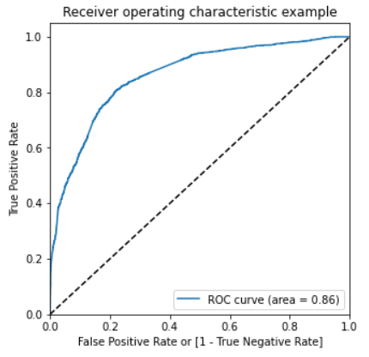
ROC Curve
•The ROC curve shows that the 86% of the area is under the curve.
•The classification probability of lead conversion (1/0) is very high by the model.

Slide 5
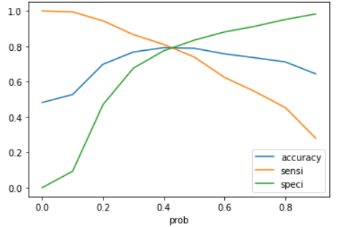
•Optimal probability cutoff is identified as 0.4 for better accuracy of the classification of lead conversion.
•With 0.4 cutoff the model has
–Accuracy : 79%
–Sensitivity : 81%
–Specificity : 77%

Slide 6
Confusion matrix on Test data
Actual/Predicted | Not Converted | Converted
Not Converted | 1823 | 489
Converted | 444 | 1705
Accuracy : 79% | Sensitivity : 81% | Specificity : 77%
The model can predict if a lead can be converted or not with 79% accuracy on unseen data. This will help the company to predict the probability of ‘hot’ leads with 79% accuracy.
Also, the model can predict the probability of a lead which are actually converted over total converted lead with 81% chances.
The model’s prediction of a lead not getting converted is also very high (77% over unseen data). This means that the X education company will save lot of time and resources by discarding low scoring leads.

Slide 7
Recommendation
•The leads which have high score can be treated as “hot” leads and sales team need to follow up as there is high possibility to convert those leads.
•Leads who have applied for ‘Do Not Email’ already does not needs to be attended again.
•Based on the previous chat conversations if the lead is classified as ‘Might be’ or ‘Worst’ then those leads can be ignored.

Slide 8
Thank You

